Slide 1

Contact:
djacobs1@uncc.edu
Part 4
Body-bar Pebble Game
Donald Jacobs, Professor
Department of Physics and Optical Science

Slide 2
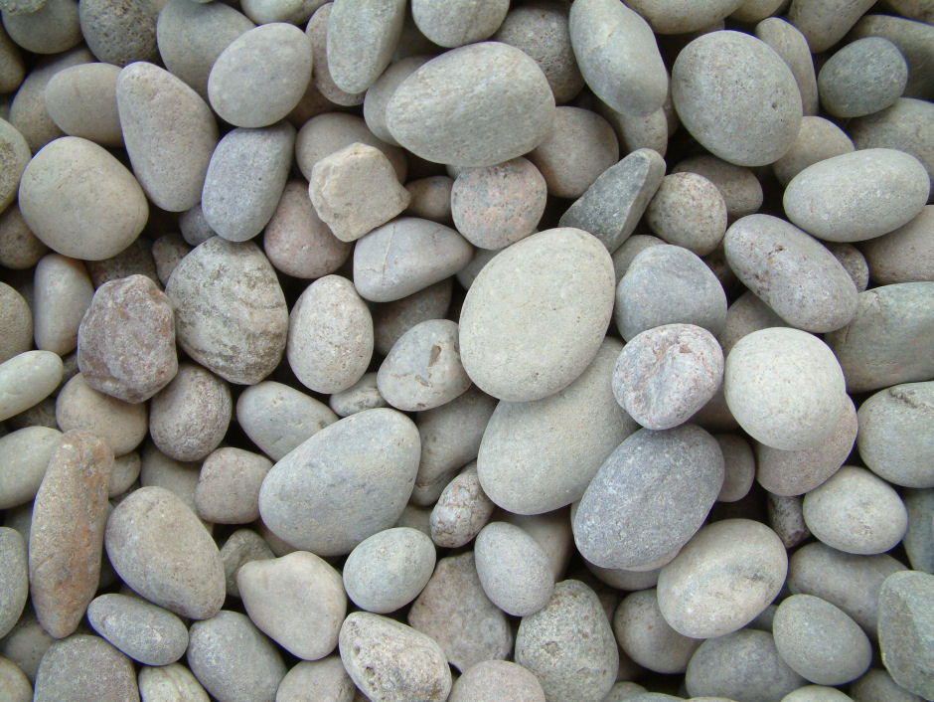
The Pebble Game
Floppy Inclusion and Rigid Substructure Topography (FIRST)
FIRST(molecular structure) → Mechanical Information
Acknowledgments
Debbie Franzblau
Bruce Hendrickson
Phil Duxbury
Mike Thorpe
Walter Whiteley
Leslie Kuhn
Mykyta Chubynsky
Andrew Rader
Brandon Hespenheide
Independent constraints
Over constrained regions
Rigid cluster decomposition
Correlated motions

Slide 3
FIRST Workflow Schematic
Input: Structure of molecule
Modeling
Transform atomic geometry into topological network of constraints
PEBBLE GAME calculation
Constraint Counting
Laman Condensation
Rigid Cluster Decomposition
Correlated Motion Decomposition
Output: Statics information

Slide 4
Input Protein Structures and Modeling
Input structure
Modeling
Pebble game
Constraint counting
Laman Condensation
Rigid Cluster Decomposition
Correlated Motion Decomposition
Output
X,Y,Z coordinates of all atoms
Use empirical rules to convert geometrical information to a topological body-bar network.
List of microscopic interactions to consider
Covalent bonding
Hydrogen bonding and Salt bridges
Packing interactions (torsion forces)
Metallic interactions
Solvent interactions

Slide 5
Modeling Covalent Bonds
Input structure
Modeling
Pebble game
Constraint counting
Laman Condensation
Rigid Cluster Decomposition
Correlated Motion Decomposition
Output
Covalent bonding
Central force interactions
Represented as a
bar-joint network
graph G
Jacobs, J. Phys. A 31, 6653 (1998)

Slide 6
Modeling Covalent Bonds
Input structure
Modeling
Pebble game
Constraint counting
Laman Condensation
Rigid Cluster Decomposition
Correlated Motion Decomposition
Output
Covalent bonding
Central force interactions
Bond-bending interactions
Represented as a
bar-joint network
graph G²
Jacobs, J. Phys. A 31, 6653 (1998)

Slide 7
Modeling Covalent Bonds
Bar-joint graph G²
Body-Bar multigraph
Jacobs, J. Phys. A 31, 6653 (1998)
Tay & Whiteley, Struct. Topol. 9, 31 (1984)

Slide 8

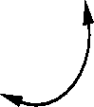
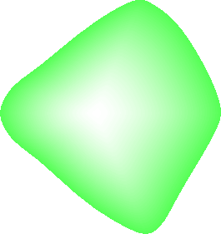
Body-bar representation
Covalent bond
6
5 bars
6
DOF = 6 + 1 = 7
= 2×6 - 5

Slide 9
Simple Covalent Bonded Ring System
Graph G representation:

Slide 10
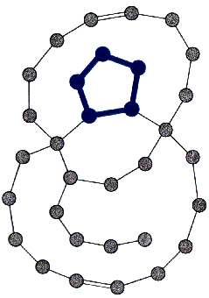
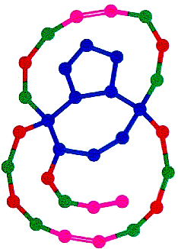
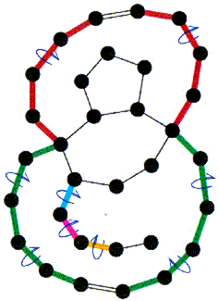
Network Rigidity of a Simple Ring System
Identification of stressed regions
Rigid cluster decomposition
Characterization of flexible regions
Jacobs, Kuhn and Thorpe, Flexible and rigid regions in proteins, p357-384
in Rigidity Theory and Applications (1999) (Eds. Thorpe & Duxbury

Slide 11
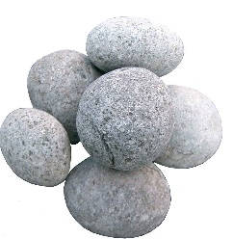
Simple Covalent Bonded Ring System
Graph G representation:

Slide 12
3D Body-bar Pebble Game
Place 6 pebbles on n-connected bodies (n>1) & 5 pebbles on 1-connected bodies

Slide 13
3D Body-bar Pebble Game
Place 6 bars at peptide bond

Slide 14
3D Body-bar Pebble Game
Cover all 6 bars

Slide 15
3D Body-bar Pebble Game
Place 5 bars for rotatable dihedral bond

Slide 16
3D Body-bar Pebble Game
Cover all 5 bars

Slide 17
3D Body-bar Pebble Game
Place 5 bars for rotatable dihedral bond

Slide 18
3D Body-bar Pebble Game
Cover all 5 bars

Slide 19
3D Body-bar Pebble Game
Repeat process, etc, …

Slide 20
3D Body-bar Pebble Game
A freely-jointed chain with 9 internal dof
Reference
6 dof

Slide 21
3D Body-bar Pebble Game
Place 6 bars at the other peptide bond and then cover all of them

Slide 22
3D Body-bar Pebble Game
Continue process, etc, …

Slide 23
3D Body-bar Pebble Game
Pebble Exchange Operation

Slide 24
3D Body-bar Pebble Game
Pebble Exchange Operation

Slide 25
3D Body-bar Pebble Game
Pebble Search/Exchange Operation

Slide 26
3D Body-bar Pebble Game
Pebble Search/Exchange Operation

Slide 27
3D Body-bar Pebble Game
Pebble Search/Exchange Operation

Slide 28
3D Body-bar Pebble Game
Pebble Search/Exchange Operation

Slide 29
3D Body-bar Pebble Game
Pebble Search/Exchange Operation

Slide 30
3D Body-bar Pebble Game
Pebble Search/Exchange Operation

Slide 31
3D Body-bar Pebble Game
Continue process, etc, …
?

Slide 32
3D Body-bar Pebble Game
Pebble Search/Exchange Operation

Slide 33
3D Body-bar Pebble Game
Continue placing 5 bars at rotatable bonds
?

Slide 34
3D Body-bar Pebble Game
Pebble Search/Exchange Operation

Slide 35
3D Body-bar Pebble Game
Continue placing 5 bars at rotatable bonds
?

Slide 36
3D Body-bar Pebble Game
Continue placing 5 bars at rotatable bonds

Slide 37
3D Body-bar Pebble Game
Pebble Search/Exchange Operation

Slide 38
3D Body-bar Pebble Game
Pebble Search/Exchange Operation

Slide 39
3D Body-bar Pebble Game
Pebble Search/Exchange Operation

Slide 40
3D Body-bar Pebble Game
FAILED PEBBLE SEARCH RECORD Laman subgraph

Slide 41
3D Body-bar Pebble Game
Laman subgraph CONDENSATION

Slide 42
3D Body-bar Pebble Game
Laman subgraph CONDENSATION
?

Slide 43
3D Body-bar Pebble Game
Continue placing 5 bars at rotatable bonds

Slide 44
3D Body-bar Pebble Game
Pebble Search/Exchange Operation

Slide 45
3D Body-bar Pebble Game
Continue placing 5 bars at rotatable bonds
?

Slide 46
3D Body-bar Pebble Game
Pebble Search/Exchange Operation

Slide 47
3D Body-bar Pebble Game
Pebble Search/Exchange Operation

Slide 48
3D Body-bar Pebble Game
Pebble Search/Exchange Operation

Slide 49
3D Body-bar Pebble Game
Rigid Cluster Decomposition Apply auxiliary external constraint

Slide 50
3D Body-bar Pebble Game
Rigid Cluster Decomposition Apply auxiliary external constraint

Slide 51
3D Body-bar Pebble Game
Rigid Cluster Decomposition Apply auxiliary external constraint

Slide 52
3D Body-bar Pebble Game
Rigid Cluster Decomposition Apply auxiliary external constraint

Slide 53
3D Body-bar Pebble Game
Rigid Cluster Decomposition Apply auxiliary external constraint

Slide 54
3D Body-bar Pebble Game
Rigid Cluster Decomposition Apply auxiliary external constraint
Rigid
region

Slide 55
3D Body-bar Pebble Game
Each Rigid Body (circle) can belong to one and only one rigid substructure

Slide 56
3D Body-bar Pebble Game
Correlated Motion Decomposition Externally constrain each hinge

Slide 57
3D Body-bar Pebble Game

Slide 58
Modeling Molecular Interactions
0-connected bodies: assign 3 dof
1-connected bodies: assign 5 dof
n-connected bodies: assign 6 dof for n>1
The body-bar pebble game allows different numbers of bars connecting rigid bodies.
Increase in mechanical relevance of a constraint
b=1
b=2
b=3
b=4
b=5
b=6
Increase in number of bars within a constraint

Slide 59
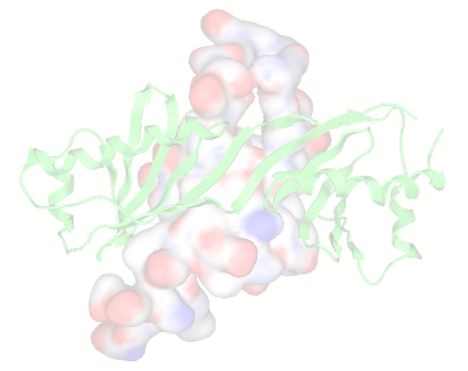
Virtual Pebble Game (VPG)
Why stop at integer values?
Let b be a real number.
0 ≤ b ≤ 6
b
"Essentially, all models are wrong, but some are useful.” --- George Box
Motivation for the VPG
Running many body-bar pebble games on a random sample of constraint networks is done to obtain average mechanical properties. This process is computationally expensive and retains statistical error bars that prevent developing a robust self-consistent constraint theory (SCCT) for the DCM.
Model an ensemble of constraint networks as a single effective constraint network.
Translate pebble movements into a probability flow.
Mean Field Approximation (MFA): Maxwell constraint counting is a MFA that replaces a constraint network with uniform density of constraints, loosing detailed rigidity information. The VPG is a MFA at the edge level, which allows it to keep all mechanical information like the ensemble averaged body-bar pebble game results.

Slide 60
The VPG is Isomorphic to the PG
Suppress fluctuations at the edge level
Virtual Pebble Game Implementation
(Body-bar graphs)
DOF (or pebbles) are now continuous variables (floats).
Approximate floats using a finite level of precision.
Let 1 be represented using 100,000,000.
All edge capacities are rounded to the nearest 10⁻⁸.
Discrete operations are preserved.

Slide 61
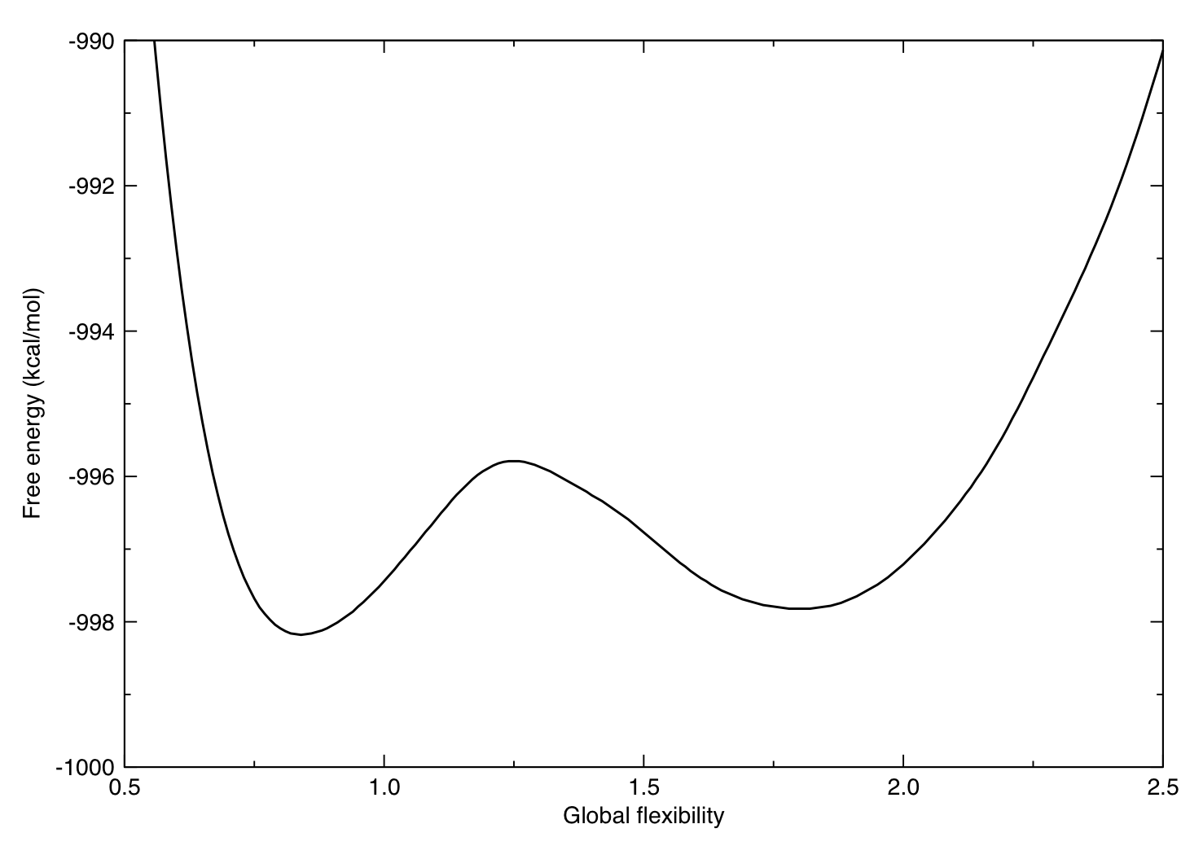
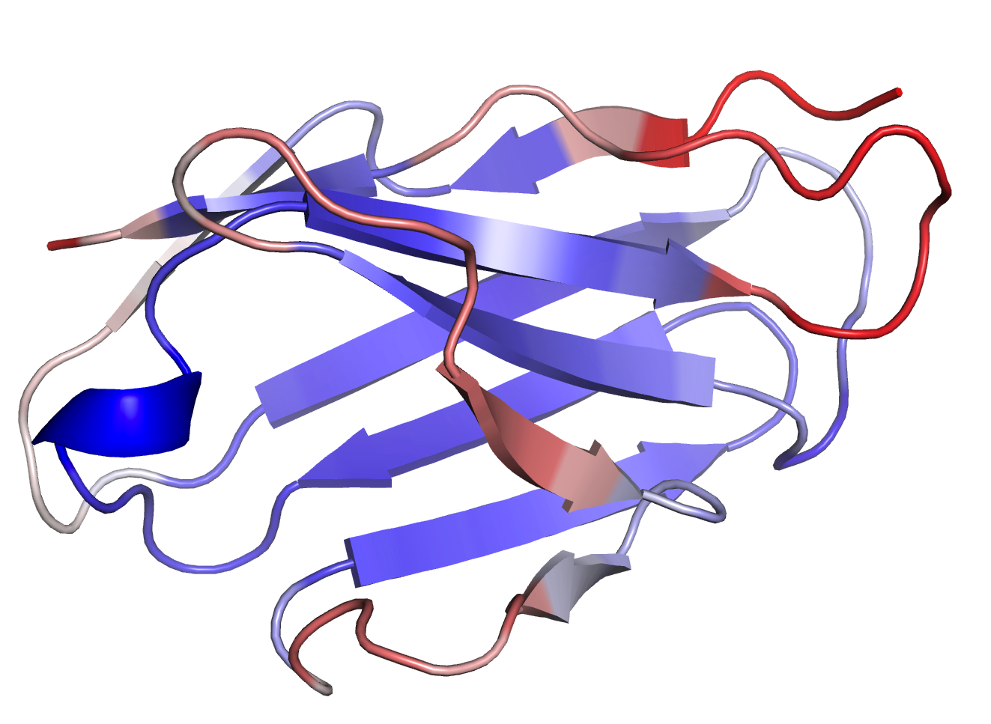
Ensemble Based Methods Probe Fluctuations
Native state fluctuations reflect properties of network rigidity
Use known X-ray crystal structure as a geometrical template
Perturb structure by breaking native state H-bonds (random dilution)
native basin

Slide 62
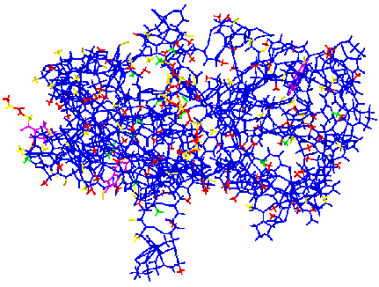
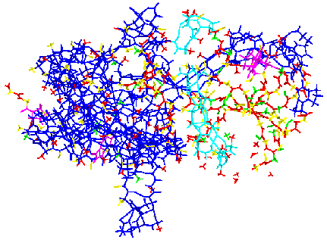
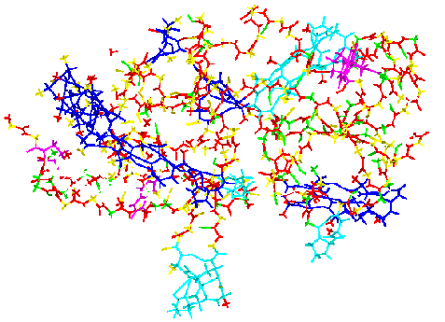
Linking Mechanics Directly with Thermodynamics
Network rigidity is regarded as an underlying mechanical interaction
Jacobs & Dallakyan (2005) Biophysical J. 88:903
Livesay et al. (2004) FEBS Letters 576:468
MECHANICS
Globally Rigid
Globally Flexible
-TS
H
H
-TS
H
-TS
STABLE representing the native state (NS)
UNSTABLE representing the transition state (TS)
STABLE representing the unfolded state (US)
THERMODYNAMICS

Slide 63
Sub-ensembles of constraint networks
Rigidity properties change depending on number of H-bonds
Total number of constraints = covalent bond constraints + H-bond constraints
N_{C} = N_{CB} + N_{HB}
Quenched
(always ON)
Fluctuating
(ON or OFF)
A typical value for maximum number of H-bonds
300
Binomial coefficients give the number of distinct constraint networks with N_{HB} H-bonds present.
0
# H-bonds

Slide 64
Sub-ensembles of constraint networks
Rigidity properties change depending on number of H-bonds
How to estimate average graph rigidity properties in each sub-ensemble?
0
N₁
N₂
N₃
# H-bonds
+ . . .
+ . . .
+ . . .

Slide 65
Sub-ensembles of constraint networks
Rigidity properties change depending on number of H-bonds
How to estimate average graph rigidity properties in each sub-ensemble?
Method 1: Maxwell Constraint Counting (estimates number of DOF only)
0
N₁
N₂
N₃
# H-bonds
+ . . .
+ . . .
+ . . .

Slide 66
Sub-ensembles of constraint networks
Rigidity properties change depending on number of H-bonds
How to estimate average graph rigidity properties in each sub-ensemble?
Method 2: Monte Carlo sampling (typically run 200 pebble games)
0
N₁
N₂
N₃
# H-bonds
+ . . .
+ . . .
+ . . .

Slide 67
Sub-ensembles of constraint networks
Rigidity properties change depending on number of H-bonds
How to estimate average graph rigidity properties in each sub-ensemble?
Method 3: Virtual Pebble Game (estimates all graph rigidity properties)
0
N₁
N₂
N₃
# H-bonds
+ . . .
+ . . .
+ . . .

Slide 68
Maxwell Constraint Counting (MCC)
Mean field approximation based on an effective medium approximation
0
N₁
N₂
N₃
# H-bonds
Rigidity Transition
DOF
As H-bonds are added
0
25%
50%
75%
100%
MCC assumes all constraints are independent until the entire network is globally rigid, at which point all additional constraints are redundant.

Slide 69
Maxwell Constraint Counting (MCC)
Suppress constraint fluctuations globally
0
N₁
N₂
N₃
# H-bonds
MCC assumes all constraints are independent until the entire network is globally rigid, at which point all additional constraints are redundant.
MCC assumes all constraints are independent until the entire network is globally rigid, at which point all additional constraints are redundant. The mean field approximation defines an effective medium with uniform constraint density.

Slide 70
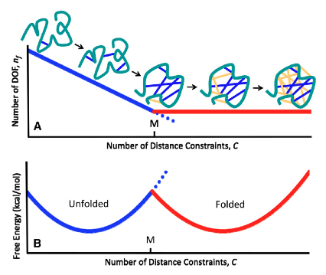
Two State Thermodynamics is Captured by MCC
Two extreme basins form
Vorov, Livesay and Jacobs, Biophysical J. 100:1129-38 (2011)

Slide 71
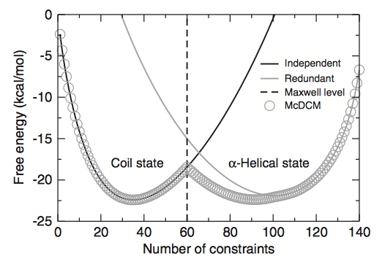
Two State Thermodynamics is Captured by MCC
Two extreme basins form
Vorov, Livesay and Jacobs, Biophysical J. 100:1129-38 (2011)
Vorov, Livesay and Jacobs, Biophysical J. 97:3000-09 (2009)

Slide 72
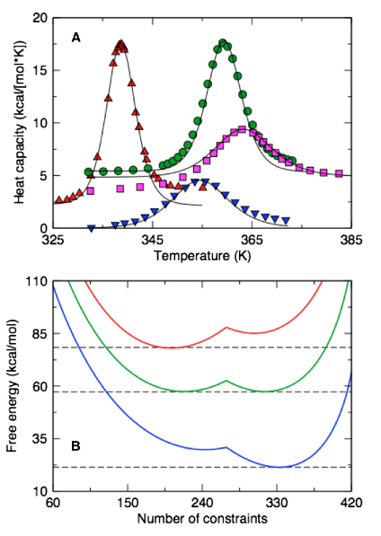
Two State Thermodynamics is Captured by MCC
Two extreme basins form
Vorov, Livesay and Jacobs, Biophysical J. 100:1129-38 (2011)
Vorov, Livesay and Jacobs, Biophysical J. 97:3000-09 (2009)

Slide 73
The Virtual Pebble Game (VPG)
An effective medium approximation applied to fluctuating constraints
Simple example:
Quenched covalent bond
1 H-bond
Fluctuating H-bond
Prob = p(1-p)
1 H-bond
(1)
(1)
(p)
Prob = p(1-p)
(1)
(1)
(1)
(1)
(p)
(1)
0 H-bond
Prob = (1-p)²
Note: 2² distinct
constraint networks
2 H-bond
Prob = p²

Slide 74
Pebble Game (PG)
Body-bar example
Pebble Game Rules
(Body-bar graphs)
Atoms → vertices
Each vertex is assigned 6 DOF
Covalent bonds → edges
Each edge is assigned 5 bars
H-bonds
broken → no edge with probability (1-p)
present → edge with probability p
Each edge is assigned 5 bars

Slide 75
Pebble Game (PG)
Body-bar example
No constraints placed yet.
Pebble Game Rules
(Body-bar graphs)
Atoms → vertices
Each vertex is assigned 6 DOF
present HB
Covalent bonds → edges
Each edge is assigned 5 bars
H-bonds
broken → no edge with probability (1-p)
present → edge with probability p
Each edge is assigned 5 bars
broken H-bond
present HB

Slide 76
Pebble Game (PG)
Body-bar example
All covalent bonds placed.
Pebble Game Rules
(Body-bar graphs)
Atoms → vertices
Each vertex is assigned 6 DOF
present HB
Covalent bonds → edges
Each edge is assigned 5 bars
H-bonds
broken → no edge with probability (1-p)
present → edge with probability p
Each edge is assigned 5 bars
broken H-bond
present HB

Slide 77
Pebble Game (PG)
Body-bar example
All covalent bonds placed.
Two H-bonds are present and placed.
Pebble Game Rules
(Body-bar graphs)
Atoms → vertices
Each vertex is assigned 6 DOF
present HB
Covalent bonds → edges
Each edge is assigned 5 bars
H-bonds
broken → no edge with probability (1-p)
present → edge with probability p
Each edge is assigned 5 bars
broken H-bond
present HB

Slide 78
Pebble Game (PG)
Body-bar example
All covalent bonds placed.
Two H-bonds are present and placed.
Pebble Game Rules
(Body-bar graphs)
Atoms → vertices
Each vertex is assigned 6 DOF
Covalent bonds → edges
Each edge is assigned 5 bars
H-bonds
broken → no edge with probability (1-p)
present → edge with probability p
Each edge is assigned 5 bars

Slide 79
The VPG is Isomorphic to the PG
Suppress fluctuations at the edge level
Virtual Pebble Game Rules
(Body-bar graphs)
Pebble Game Rules
(Body-bar graphs)
Atoms → vertices
Each vertex is assigned 6 DOF
Atoms → vertices
Each vertex is assigned 6 DOF
same
Covalent bonds → edges
Each edge is assigned 5 bars
H-bonds
broken → no edge with probability (1-p)
present → edge with probability p
Each edge is assigned 5 bars

Slide 80
The VPG is Isomorphic to the PG
Suppress fluctuations at the edge level
Virtual Pebble Game Rules
(Body-bar graphs)
Pebble Game Rules
(Body-bar graphs)
Atoms → vertices
Each vertex is assigned 6 DOF
Atoms → vertices
Each vertex is assigned 6 DOF
Covalent bonds → edges
Each edge is assigned 5 bars
Covalent bonds → edges
Each edge is assigned 5 bars
same
H-bonds
broken → no edge with probability (1-p)
present → edge with probability p
Each edge is assigned 5 bars

Slide 81
The VPG is Isomorphic to the PG
Suppress fluctuations at the edge level
Virtual Pebble Game Rules
(Body-bar graphs)
Pebble Game Rules
(Body-bar graphs)
Atoms → vertices
Each vertex is assigned 6 DOF
Atoms → vertices
Each vertex is assigned 6 DOF
Covalent bonds → edges
Each edge is assigned 5 bars
Covalent bonds → edges
Each edge is assigned 5 bars
H-bonds
average state → 5p + 0(1-p)
Each edge is assigned 5p bars
H-bonds
broken → no edge with probability (1-p)
present → edge with probability p
Each edge is assigned 5 bars
Suppress (ON/OFF) fluctuations within an edge
Retain spatial location of the fluctuating edges.

Slide 82
The VPG is Isomorphic to the PG
Suppress fluctuations at the edge level
Virtual Pebble Game Rules
(Body-bar graphs)
No constraints placed yet.
5
6
6
Atoms → vertices
Each vertex is assigned 6 DOF
DOF
5p
5
Covalent bonds → edges
Each edge is assigned 5 bars
edge capacities
5
6
6
H-bonds
average state → 5p + 0(1-p)
Each edge is assigned 5p bars
Suppress intra-edge fluctuation
5p
5p
5
6
6
5

Slide 83
The VPG is Isomorphic to the PG
Suppress fluctuations at the edge level
Virtual Pebble Game Rules
(Body-bar graphs)
All covalent bonds placed.
5
1
5
1
Atoms → vertices
Each vertex is assigned 6 DOF
5
5p
Covalent bonds → edges
Each edge is assigned 5 bars
5
5
1
5
1
H-bonds
average state → 5p + 0(1-p)
Each edge is assigned 5p bars
Suppress intra-edge fluctuation
5
5p
5p
5
1
5
1
5

Slide 84
The VPG is Isomorphic to the PG
Suppress fluctuations at the edge level
Virtual Pebble Game Rules
(Body-bar graphs)
All covalent bonds placed.
H-bonds are placed at average capacity.
5
0
5
1
Atoms → vertices
Each vertex is assigned 6 DOF
1
5
5p
For this example,
Consider: p = 2/5
Covalent bonds → edges
Each edge is assigned 5 bars
5
5
0
4
1
0
H-bonds
average state → 5p + 0(1-p)
Each edge is assigned 5p bars
Suppress intra-edge fluctuation
2
5
5p
5p
5
1
6
5
0
5

Slide 85
The VPG is Isomorphic to the PG
Suppress fluctuations at the edge level
Virtual Pebble Game Rules
(Body-bar graphs)
All covalent bonds placed.
H-bonds are placed at average capacity.
5
0
5
1
Atoms → vertices
Each vertex is assigned 6 DOF
1
5
2
For this example,
Consider: p = 2/5
Covalent bonds → edges
Each edge is assigned 5 bars
5
5
0
4
1
0
H-bonds
average state → 5p + 0(1-p)
Each edge is assigned 5p bars
Suppress intra-edge fluctuation
2
5
2
2
5
1
6
5
0
5

Slide 86
Virtual Pebble Game Results
Three dimensional diluted lattices
Showing VPG results for four different lattice models as typical representative examples.
bar-PG considers all 5 bars within an edge as independent so that it is possible to have 0,1,2,3,4,5 constraints in contrast to the cooperative case of (0 or 5).

Slide 87
Virtual Pebble Game Results
Based on a non-redundant dataset of 272 proteins
Showing VPG results for four different proteins as typical representative
examples
statistical
error bars
precise
Gonzalez et. al. (2012) PLoS ONE 7(2): e29176.

Slide 88
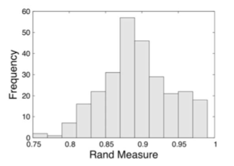
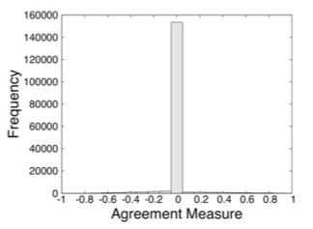
Virtual Pebble Game Results
Based on a non-redundant dataset of 272 proteins
Showing worst case agreement
excellent results
very
good
results
Deviation away from majority PG vote.
Rand Measure
Error Measure
For a given protein, the # of H-bonds that lead to the greatest disagreement is used to benchmark the worse case errors in terms of the Rand and error measures
Gonzalez LC, Wang H, Livesay DR, Jacobs DJ (2012) Calculating Ensemble Averaged Descriptions of Protein Rigidity without Sampling. PLoS ONE 7(2): e29176.

Slide 89
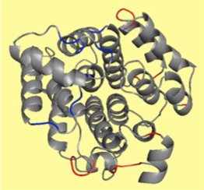
Virtual Pebble Game Results
Based on a non-redundant dataset of 272 proteins
Example protein case showing where errors between VPG and average PG results appear.
Blue
VPG over estimates rigidity
RED
VPG over estimates flexibility
GREY
VPG agrees with majority PG results.
Gonzalez et. al. (2012) PLoS ONE 7(2): e29176.

Slide 90
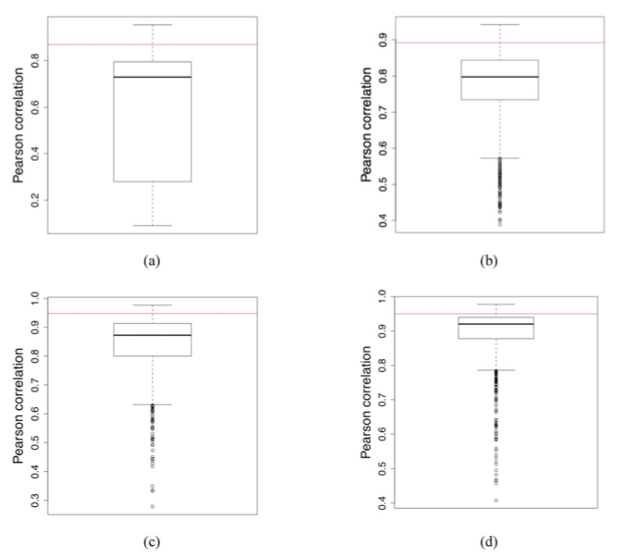
Virtual Pebble Game Results
Based on a non-redundant dataset of 272 proteins
Correlations between residue to residue mechanical couplings.
RED LINE
VPG results correlated to average PG results.
Box plot created based on correlating all 1000 PG results to the average PG result given by black line.
Showing 4 protein cases
Gonzalez et. al. (2012) PLoS ONE 7(2): e29176.

Slide 91
Conclusions
Virtual Pebble Game Characteristics
Calculation of the number of DOF in a network is much more accurate than Maxwell Constraint Counting.
Provides detailed information about network rigidity.
Provides precise results without statistical error bars.
Less accurate than sampled averages over 1000 PGs but only requires one run, instead of 1000 runs. Thus, a dramatic speedup, with highest possible precision for the price of little systematic error.
Remark: The VPG provides the necessary precision for advanced free energy calculations in proteins [1,2]. The precision and speedup enhances in silico high throughput screening applications in protein design and drug discovery.
[1] D.J. Jacobs, Computer Implemented System for Quantifying Stability and Flexibility Relationships in Macromolecules, U.S. Patent No. 8,244,504 (2012).
[2] D.J. Jacobs, An Interfacial Thermodynamics Model for Protein Stability, Biophysics, Ed: A.N. Misra, Intech publishers, pages 91-132, ISBN 978-953-51-0376-9 (2012).

